Slide 1
goFIT:
Medium-Fi Prototyping

Slide 2

Team Fitlit
Christina Ramsey
Bryce Tham
Olivia Gregory
Denis Russu

Slide 3
Inspiration to maintain a healthier lifestyle
Value Proposition

Slide 4
Problem Overview
Although many people want to stay healthy, they rarely prioritize their health, saying they don’t have time, don’t want to wait for the long-term benefits, or prefer to do other, more social, activities.

Slide 5
Solution Overview
We want a product that offers meaningful social connection and immediate rewards when users meet fitness and nutrition goals.
This should motivate people to be more excited about maintaining a healthy lifestyle, demonstrating that the act itself - not the incentives - is worth prioritizing.

Slide 6
Representative Tasks
Create personal challenges
Invite friends to complete challenges with you
Log progress on fitness and nutrition goals

Slide 7
Create
Personal
Challenges
Medium
Easy for the user to create
Requires personal accountability
Important for our design
Creates personal motivation
Allows for goal tracking
Provides reward - sense of accomplishment - when completed
Specified for testing purposes:
“Create a personal walking challenge for this week!”

Slide 8
Invite
Friends to Complete Challenges
Complex
Should also be easy for the user to create
Comes with personal and social accountability/pressure to finish
Requires connecting with network of friends/physicians
Important for our design
Creates personal motivation - want to win
Tangible reward with real people when completed
Having a network allows physicians to check in with you and friends to keep you working towards your goals
Specified for testing purposes:
“Invite Christina to complete a swimming challenge for next week!”

Slide 9
Log
Progress on Fitness and Nutrition
Goals
Easy
Interviews say people hate doing this
Should be incredibly easy to complete or people won’t do it
Important for our design
Allows users to see long term benefits via personal history
Seeing short-term progress motivates regular activities and accomplishments
Good way for users to stay healthy - incremental progress doesn’t drastically change their lifestyles
Specified for testing purposes:
“Log that you went for a walk today!”

Slide 10
Revised Interface Design
3 major sketched UI revisions
Old/New UI comparisons

Slide 11
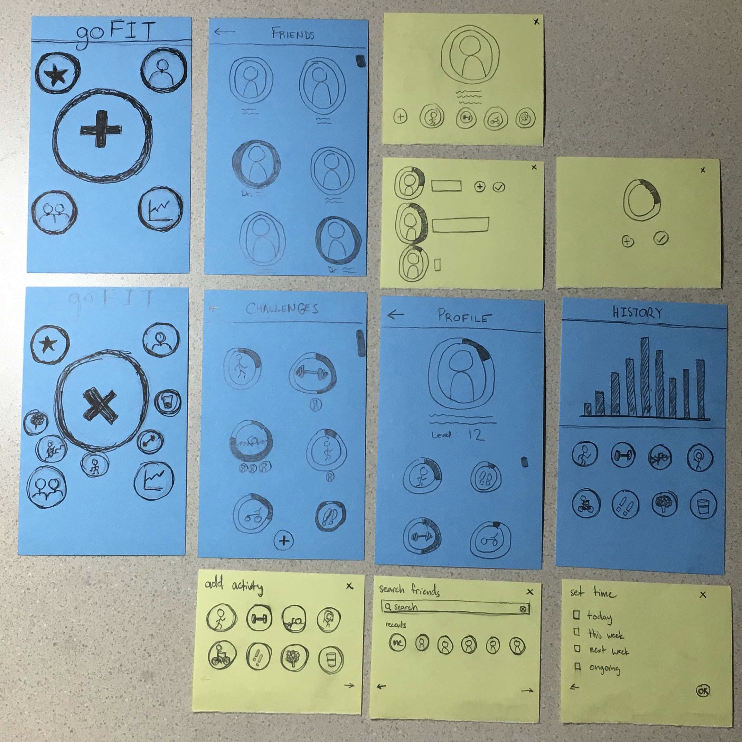
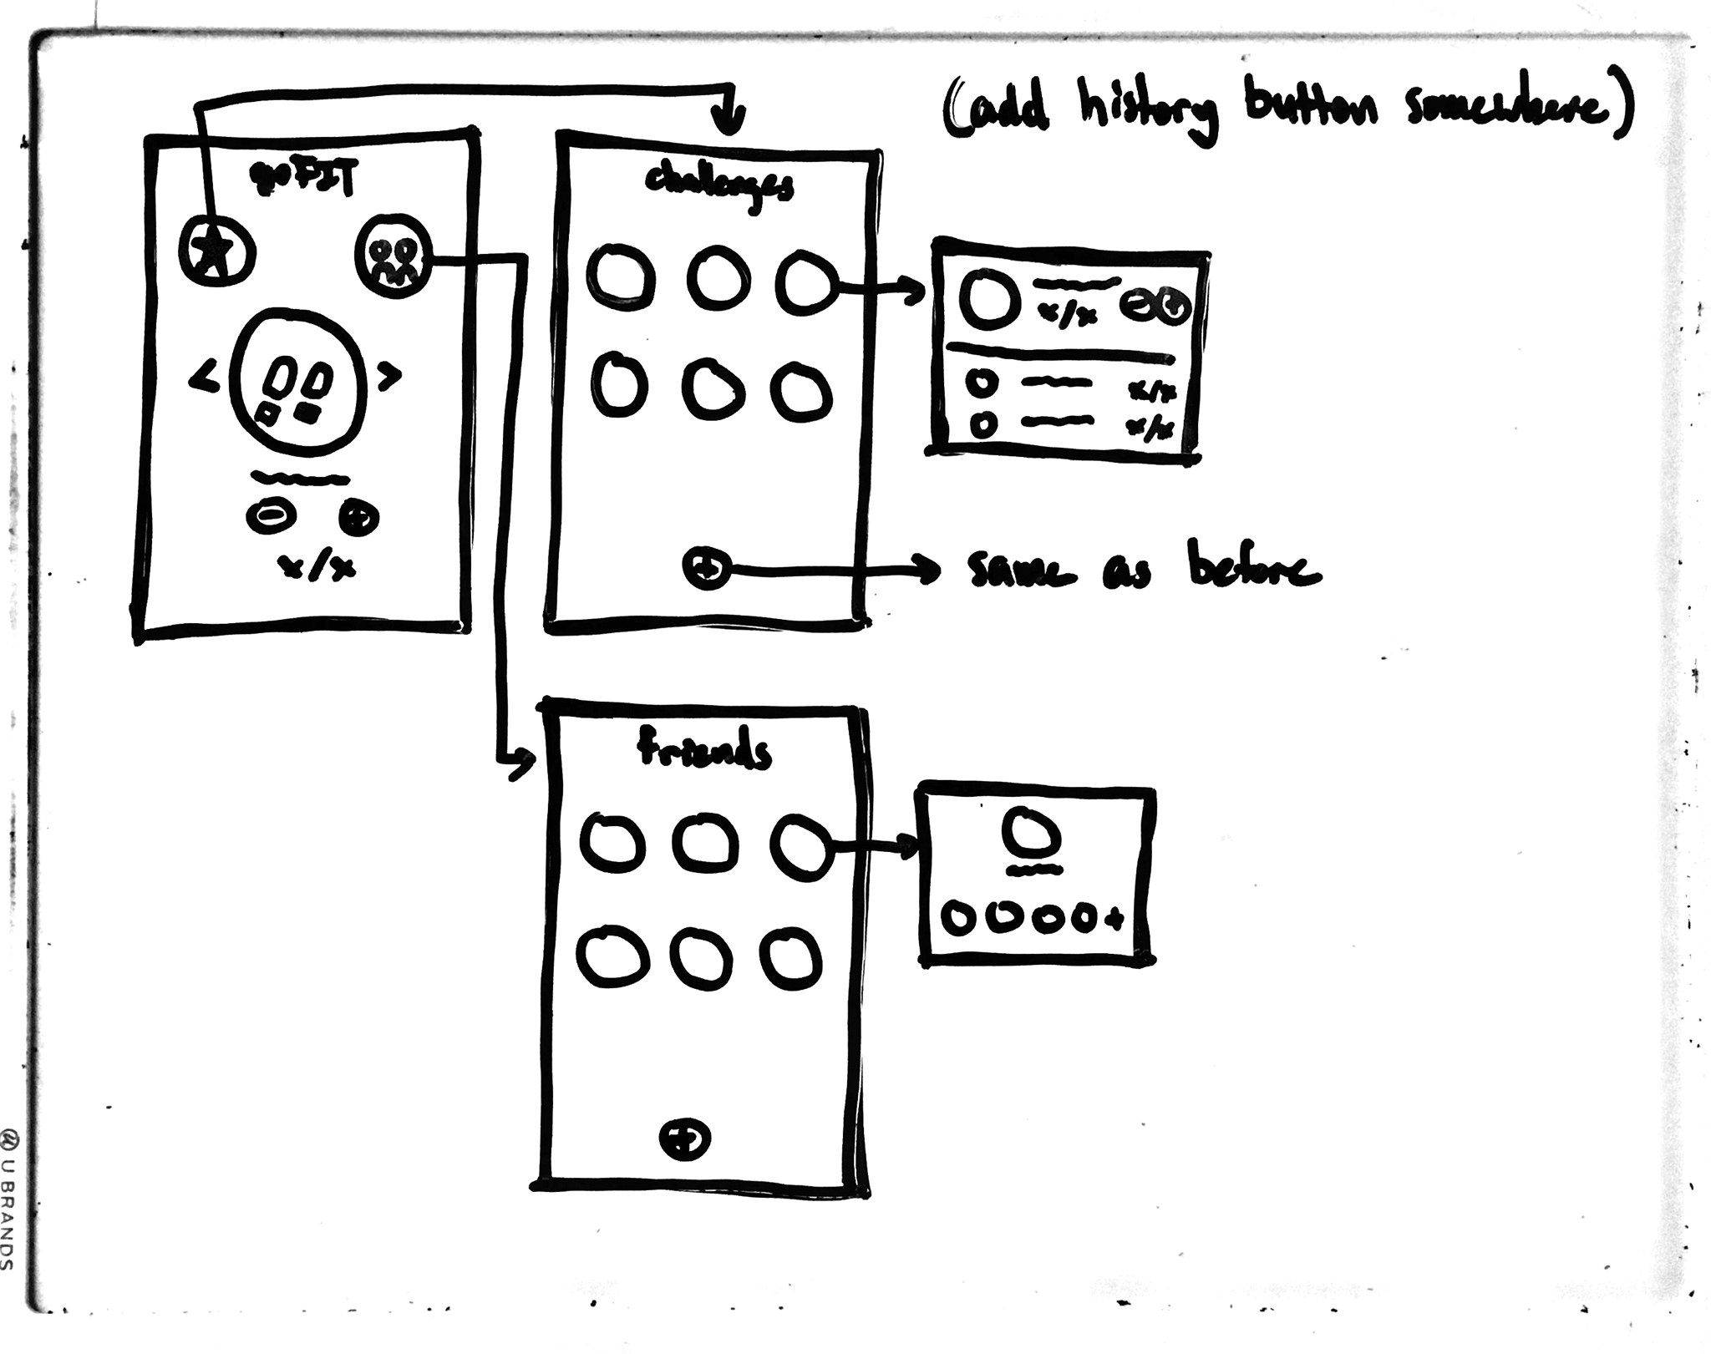
Remove primary “+” button
The “+” button on the original home screen confused every single one of our testers.
We fixed this by removing the button entirely.

Slide 12
Add challenges to dashboard
Testers didn’t understand that they could access challenges by hitting the plus button.
We got rid of that button, but still wanted users to be able to quickly log progress.
We fixed this by adding scrollable challenges directly to the home screen.

Slide 13
Add “-” button in progress tracking
Users wanted a way to detract from progress, in case they accidentally logged progress or wanted to erase something that had been automatically logged.
We fixed this by changing the progress log buttons from plus and check to minus and plus.

Slide 14
Medium-Fi Prototype
Medium-Fi Storyboards
Interface and target platform
Prototype

Slide 15
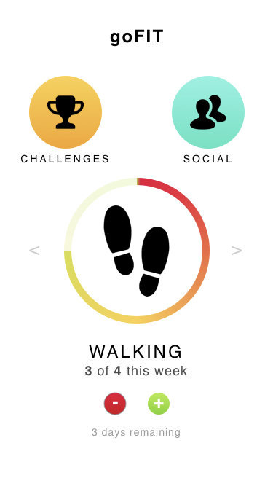
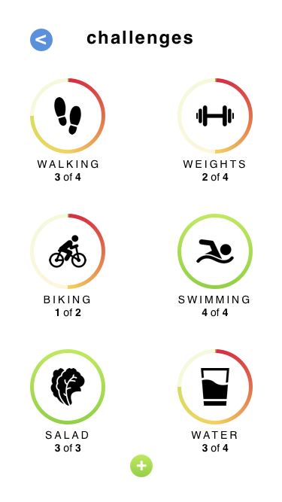
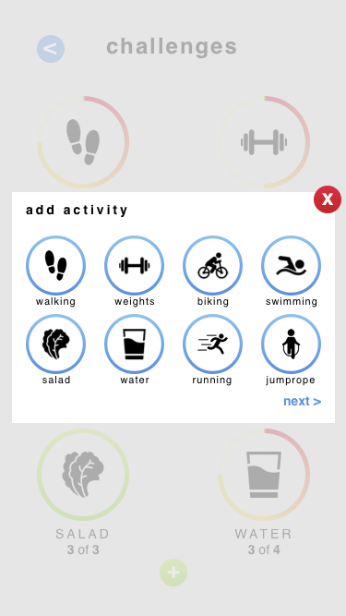
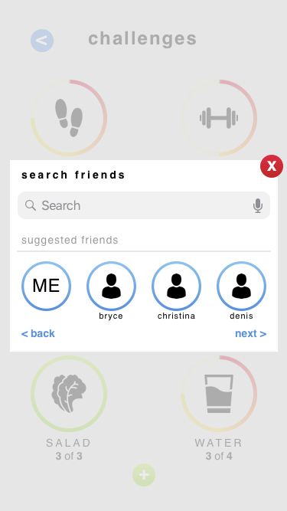
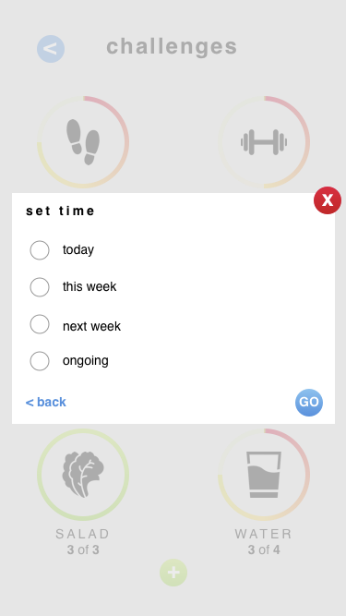
Create a personal running challenge for this week

Slide 16
2a. Invite Christina to a swimming challenge next week

Slide 17
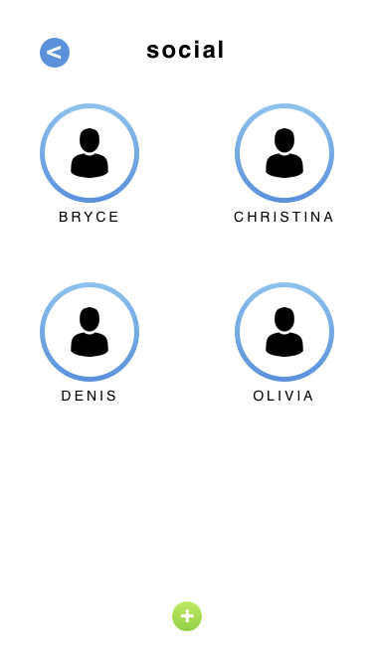
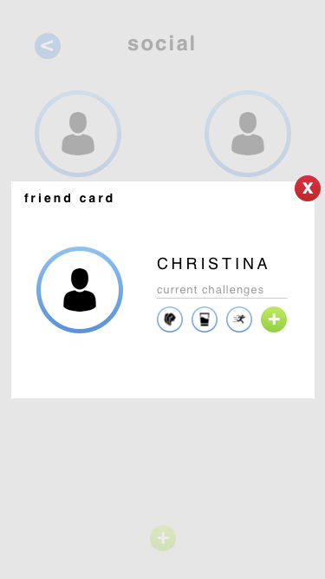
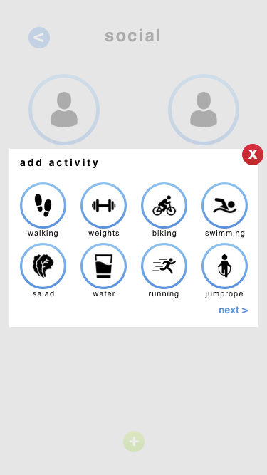
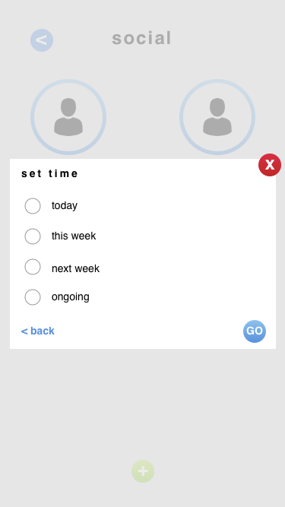
2b. Invite Christina to a swimming challenge next week

Slide 18
3a. Log progress on your current walking challenge

Slide 19
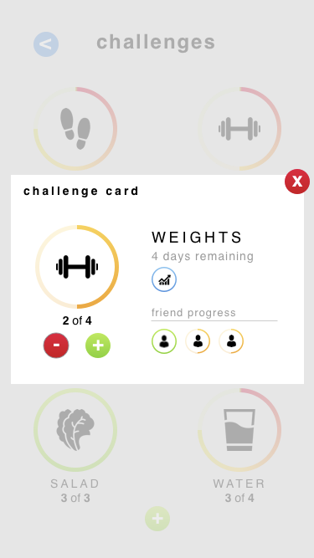
3b. Log progress on your current weightlifting challenge

Slide 20
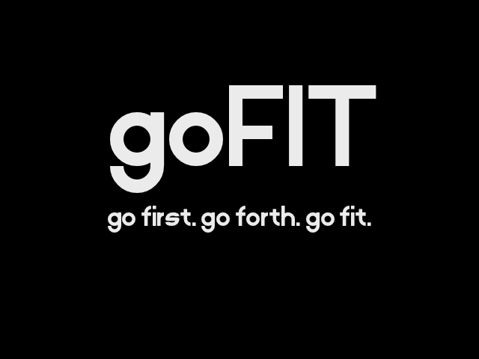
Interface and Target Platform
Mobile App
Because everyone carries their phone, even when they work out or go to the gym, a mobile app would be the simplest way of logging activities.
The phone’s sensors (primarily GPS) and input from other fitness apps can feed our data, meaning that goFIT can access other apps’ workout data and use that to populate users’ progress on challenges.

Slide 21
Prototype

Slide 22
Tools
Tools used
Limitations/Tradeoffs
Wizard of Oz techniques

Slide 23
Sketch
Sketch
“The digital design toolkit”
Used for designing the screens themselves
Extremely helpful, worked very well
Each screen generated became a static image

Slide 24
InVision
InVision
“Design better products, faster”
Used for putting the screens into an interface that mimics a mobile app
Doesn’t allow the full range of motions a user would have with their phone (swiping)
No information stored in memory: each screen transition is hard coded, so an update in part of the app doesn’t update other pages

Slide 25
Tradeoffs: Limitations of Current Prototype
Due to time constraints, full functionality was not implemented.
Not every button has a transition/screen
We implemented enough screens to demonstrate functionality, as most of our screen flows are representative of what is missing
Because we focused primarily on tasks/uses, we:
Did not create a full user profile
Did not create a screen for personal progress and history

Slide 26
Wizard of Oz/ Hard Coding
We currently have no users, so we hard coded the following information:
Challenges
Challenge progress
Friends
Friend profiles
Specific screen transitions have taken the place of storing actual data and memory
For example, if a progress bar changes, it is because we have taken the tester to a new screen instead of updating the information behind the screen

Slide 27
Thanks!

Slide 28
Credits
Special thanks to all the people who made and released these awesome resources for free:
Presentation template by SlidesCarnival

